Slide 1
Autocorrelation tests
Partial Autocorrelation function
Horizontal Blue Dotted Line = Confidence interval.
Data points within are non-significant variation (indicative of stationary)
All time series converged to a stationary state
Source code: https://github.com/christianadriano/DE_TimeSeriesAnalysis

Slide 2
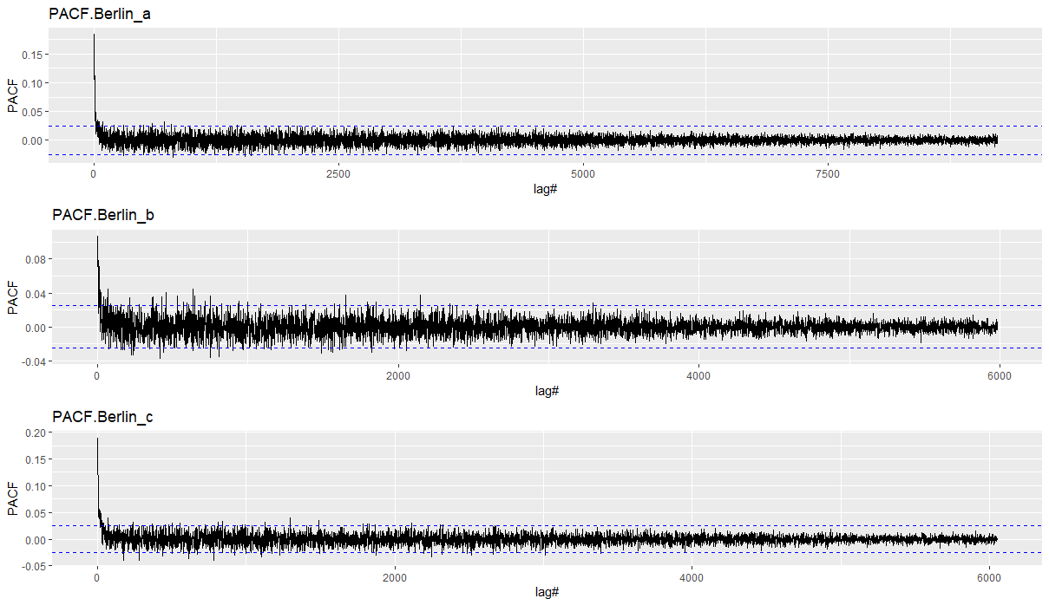

Slide 3
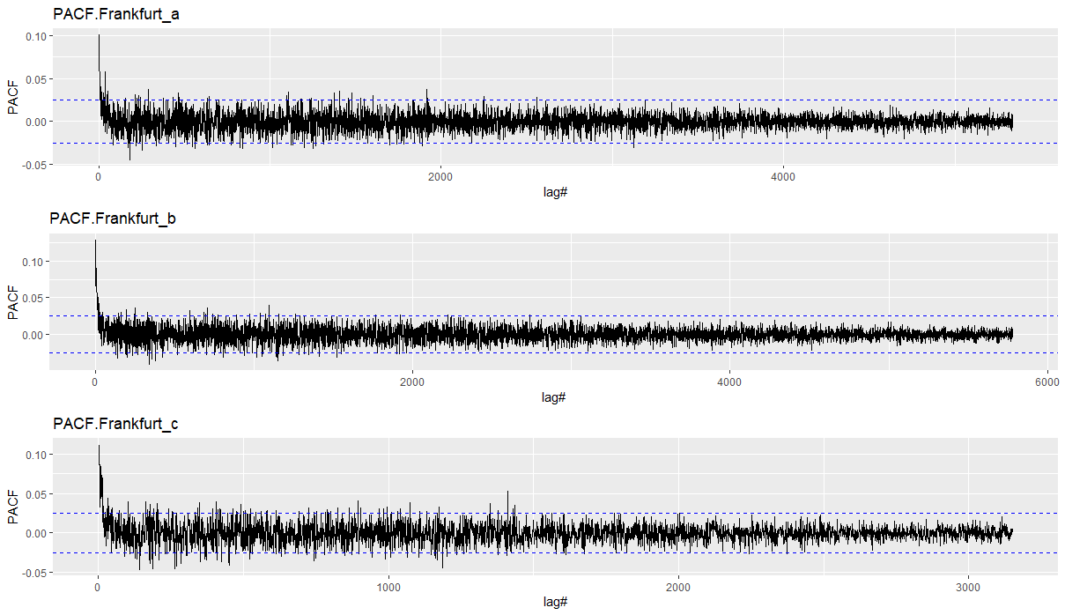

Slide 4
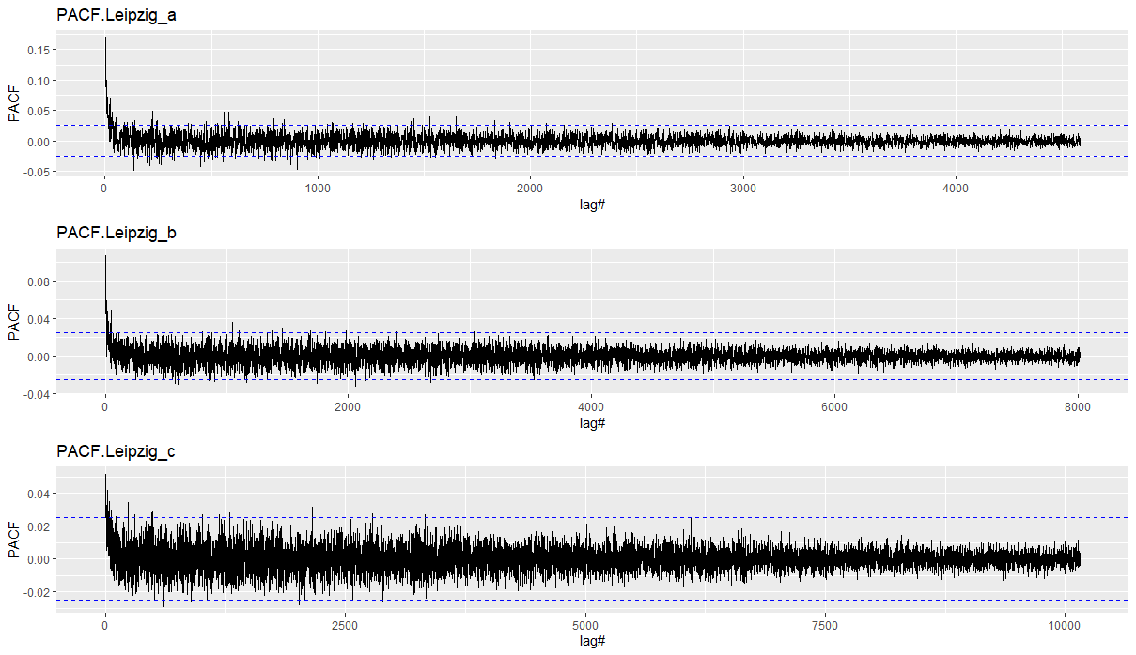

Slide 5
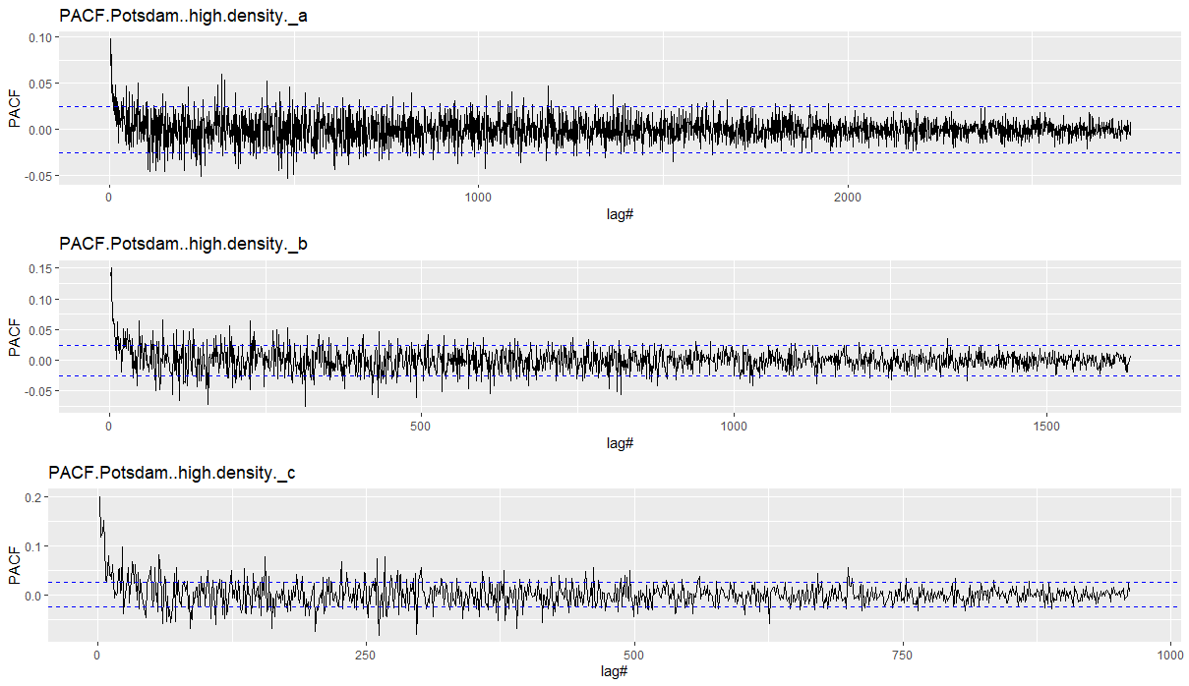

Slide 6
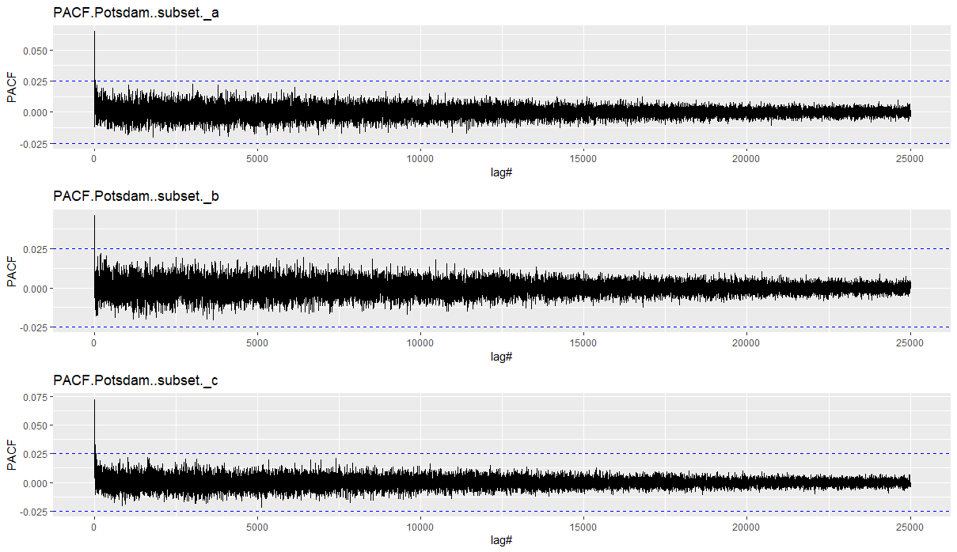

Slide 7
